Slide 1
Calmwater Charters

Slide 2
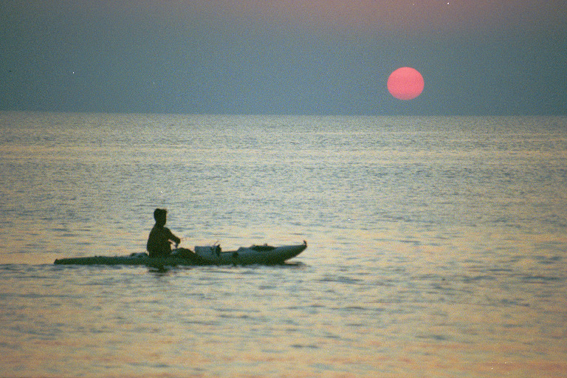
Capt. Danny Wray Calmwater Charters Saltwater Kayak Fishing
Pack and Paddle
July 16, 2008

Slide 3
Tackle
Medium light spinning gear
7 ft. medium action rod
Spinning reel – Shimano FB 4000
14 lb. test line – mono
Artificial bait
Two spinner baits
Two spoons
Two zara spooks (top water)
4 packs of plastic and jig heads - recommended colors
Black and chartruese
Chicken on a chain
Opening night
LSU Purple and chartruese

Slide 4
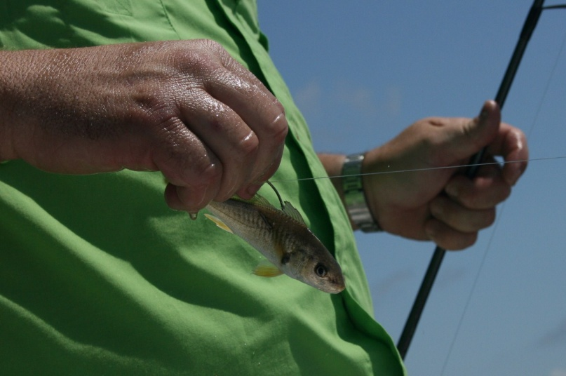
Live Bait
Keeping it alive
Aerator and insulated bait bucket (extra batteries)
Floating bait buckets
Types of Bait
Minnows (easy)
Shrimp (ok)
Croakers/pogies (hard)
How to hook a croaker -
a Speck’s favorite breakfast

Slide 5
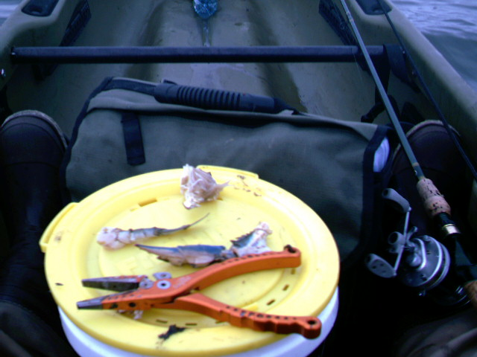
Tackle for fishing live bait
Carolina Rig – bottom fishing
#2 Kahle hook
20# leader
Small swivel
Slip sinker (1/4 oz. +)
Popping Cork for redfish
#2Kahle Hook
20# leader (short – 10-12 inches)
Popping cork (weighted)
Popping Cork for speckled trout
# Kahle Hook
20# leader (24 inches)
Pinch sinker (little)
Popping cork (weighted)
Fishing for Bull Reds with cracked crab

Slide 6
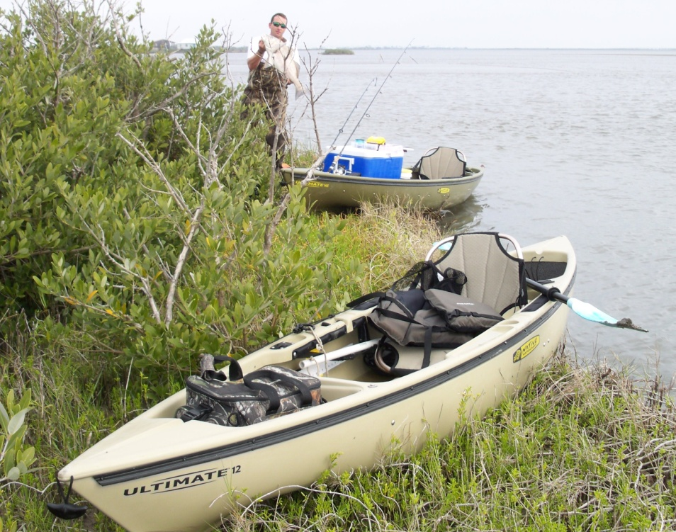
Equipment list
The basics: Kayak, paddle, PFD, stick anchor
Live bait, bait well, batteries,
Tackle, knife, pliers, stringer
Ice chest with ice
Sunscreen, water, bug spray, hat, sunglasses

Slide 7
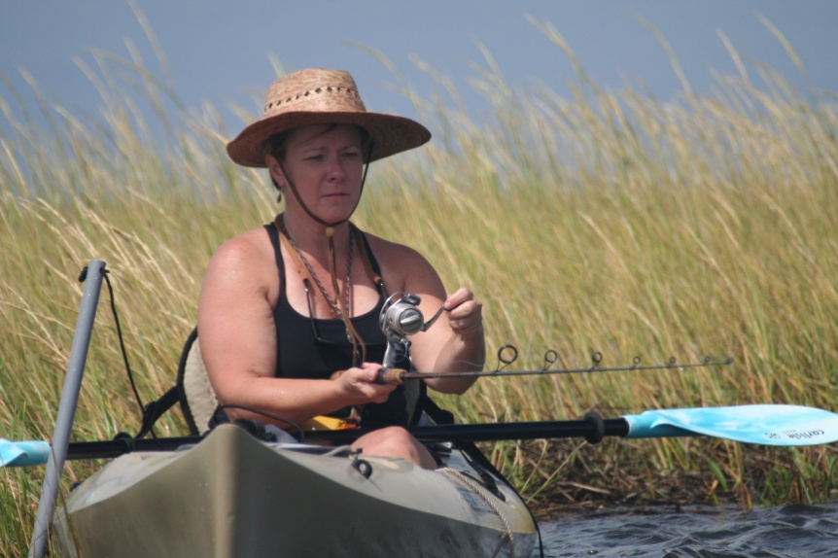
Top five reasons you can’t blame….
Me for not catching fish:
1. Bad equipment
2. LOFT (casting skills, slack line, always casting at the bank)
3. Constantly changing baits
4. Fishing bad (dirty) water
5. Fighting the boat

Slide 8
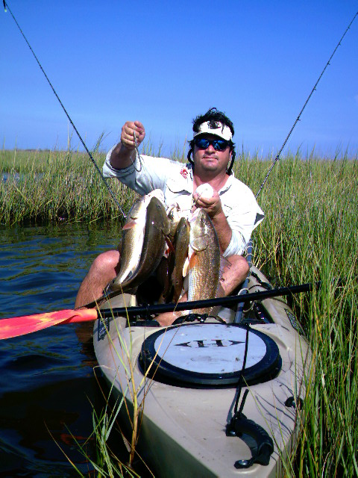
When to Go Saltwater Fishing
When your spouse is out of town
When your in-laws are in town
When the weather pattern is stable for 2-3 days
When the winds on the coast are light and variable (5-10 knots)
When there is some tidal movement

Slide 9
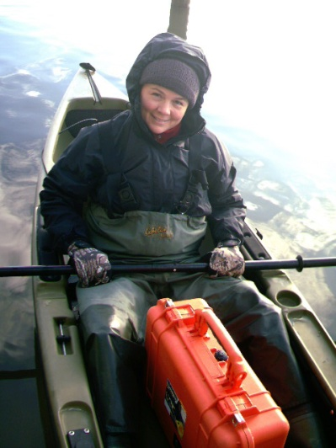
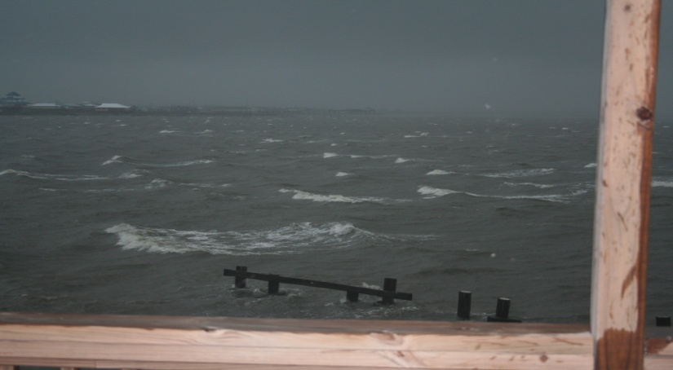
When Not to go Kayak Fishing (my bottom line)
When the coastal wind forecast is in excess of 20 knots
When the air temperature is below 45 degrees
When you can’t find clear water
During a lightning storm

Slide 10
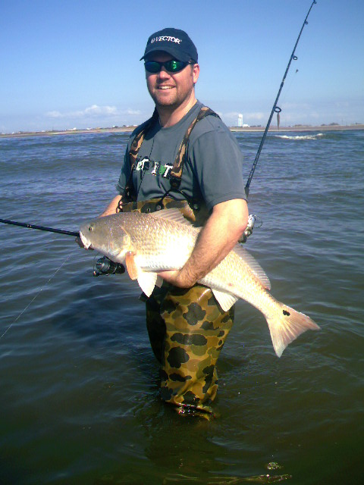
How to spot a potential honey hole
Pinch Points
Bait jumping
Birds
Moving water
Tide Line
Luck
Maintain secrecy

Slide 11
Fly Fishing in the Marsh

Slide 12
When Dentists go fishing

